Slide 1


SYSTOLIC ARCHITECTURE IMPLEMENTATION
Mujuni Ivan.
Jeju National University.
AM202526001
November 28, 2025
EMBEDDED SYSTEMS LAB

Slide 2
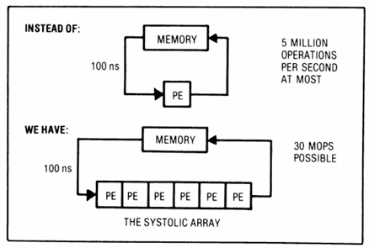
Systolic Architecture
In a systolic system, data flows from the computer memory to the many processing elements in a rhythmic fashion before it returns to the memory.
H. T. Kung likens it to blood circulating to and from the heart.
The systolic system works like an assembly line where different people work on the same car at different times and many cars are assembled simultaneously.

Slide 3

N x N Matrix for N = 4
We declare the N = 4 as shown.
We also declare the Data Width of each of the Matrix elements and the Accumulator Width.

Slide 4
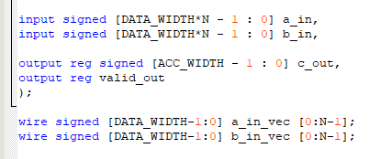
Inputs
a_in and b_in are the input vectors
a_in_vec and b_in_vec are the wires that move the inputs from one PE to the next.

Slide 5

Processing Elements
Being a 2D NxN matrix, the Systolic System uses NxN PES.
  Each of these PEs carries out a single accumulation entry and this lets the NxN accumulations proceed in Parallel.
In Commercial Designs, the array sizes are often fixed to 16x16 or 32x32 and Tiling is used to fit the Matrix Dimensions onto the Systolic Architectures.

Slide 6
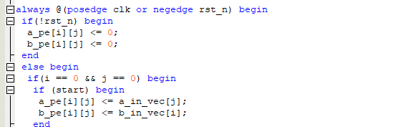
Moving the Inputs into the PEs
We begin with PE(0,0). The PE at the top Left corner.

Slide 7
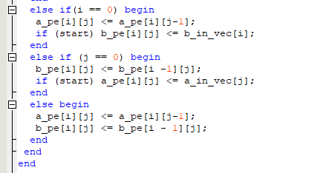
Moving the Inputs into the PEs
After PE(0,0) has received inputs, then the systolic movement of inputs into the other PEs begins.
The elements are moved from the left to the right and from the top to bottom while partial results are moved diagonally.

Slide 8
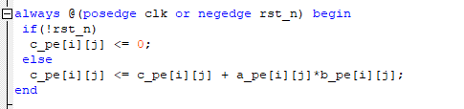
Multiply and Accumulate (MAC)
The Systolic Multiplier computes the Matrix by doing Multiply and Accumulate.
It multiples the new inputs and accumulates their Product to the previously held value, then sends the result to the next PE.
Therefore C_pe – The PE that holds the result – holds the sum of the previous product and the new Product.

Slide 9
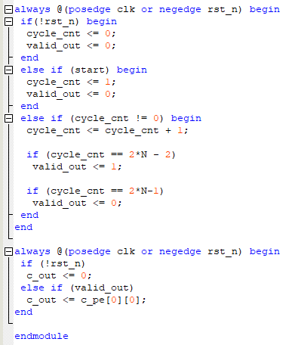
Reading the Result from the boundary PEs.
The results are read from C_out at the end of 2N-2 cycles.
2N-2 is the number of cycles it takes to fully compute an NxN Matrix Systolically.

Slide 10
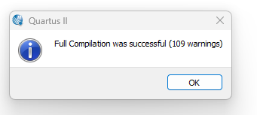
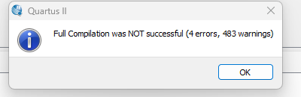
Compilation

Slide 11
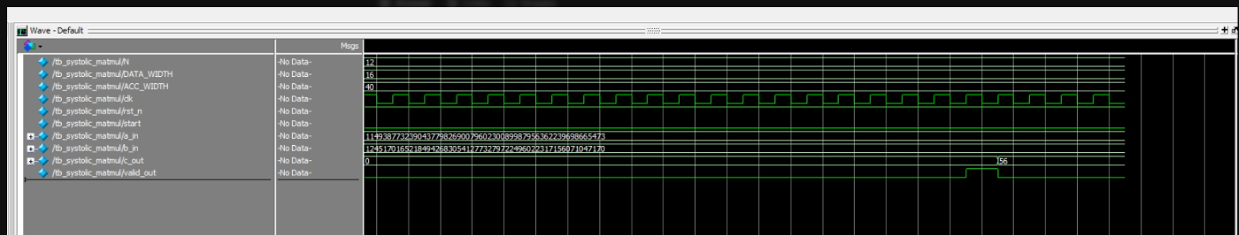
Simulation
Expected results and wave-form

Slide 12
Improvements / Future work
Implement on a DE2-115 Board.
Generate inputs automatically and not from the Test Bench

Slide 13
THANK YOU!
감사합니다

